Slide 1
Geropsychology Specialty Council
Michelle Mlinac PsyD ABPP
August 13, 2022

Slide 2
Geropsychology Specialty Council Members
Notes:
4:02
BECKY
We’d like to thank the gerontology and geropsychology organizations for their support of this conference and for their important work in promoting geropsychology at all levels.

Slide 3
Geropsychology Specialty Council
Co-Chairs
Michelle Mlinac PsyD ABPP, Past-Chair, CoPGTP
Latrice Vinson PhD, Director, Aging Portfolio, PI, APA
Student Representative
Gerontological Society Pres (Dr Peter Lichtenberg) also joins as able (informal)
Monthly meetings – zoom, recorded

Slide 4
Current Council Aims
Support Dr Vinson in her role in Office on Aging at APA
Collaborate among Geropsychology Organizations
Problem-Solve Issues in the Specialty
Represent Geropsychology on the CoS

Slide 5
Building Bridges Conference
Building Bridges Conference | Clinical Geropsychology

Slide 6
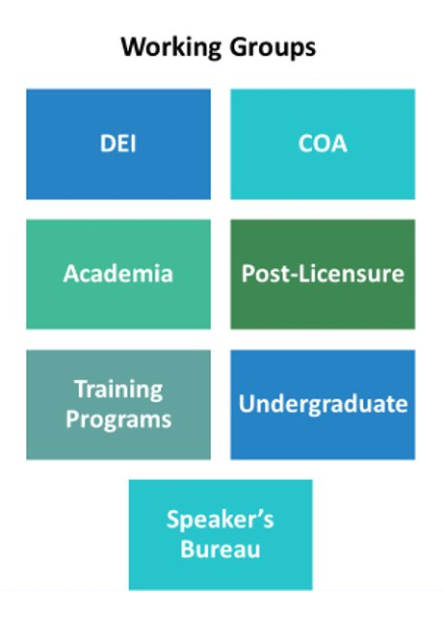
Generating Resources for Geropsychology Education

Slide 7
Using the Lens of Aging to Put Age-Friendly Principles into Practice at APA (apadivisions.org)
Teaching Tips on Advancing Age Inclusivity in Psychology

